Slide 1
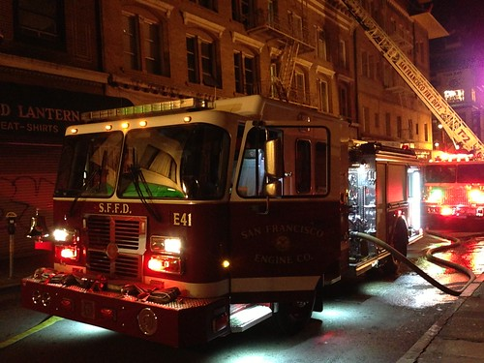
San José State University
Department of Applied Data Science
DATA 228: Big Data Technologies and Applications
Professor: Andrew Bond
Analyzing San Francisco Fire Department Service Responses
Project Group - Noob Coders
Group Members
Aishwarya Joshi
Dharani Aningi
Sai Keerthana Kattige
Supriya Kamble
Vrushali Menthe

Slide 2

Introduction
The San Francisco’s Fire Department (SFFD) was founded in year 1866.
SFFD responds to various emergencies including fires, medical incidents, and hazardous materials incidents.
The department covers an area of 47 square miles and serves a population of over 880,000 residents. The SFFD has over 1,500 firefighters and paramedics who operate from 44 fire stations throughout the city.

Slide 3
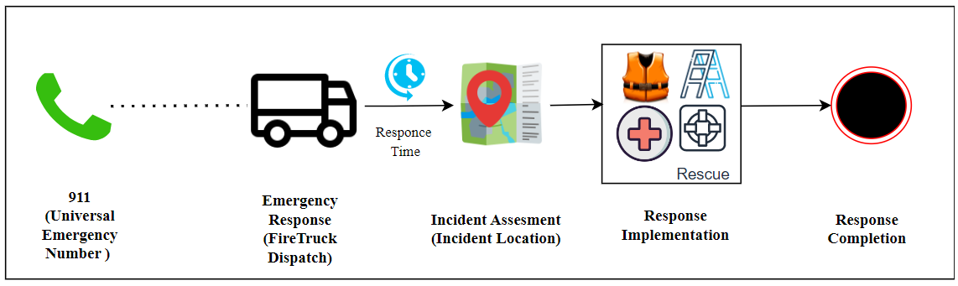
Project Background
SFFD Response Process
Typically, the fire department claims that they arrive at the scene of an emergency within six minutes of response time after receiving the call of service.
SFFD collects a lot of data on its operations, including response times, incident types, and locations.
SFFD uses technologies like Computer aided dispatch (CAD) and GPS tracking system to response to the emergencies.
These systems generate humongous data and to store this data SFFD uses traditional approaches.

Slide 4

Goals & Objectives
The project aims to understand the data and events handled by the department and support them in crisis management situations.
The goal of the project is to improve response time of the department by analyzing the data and identifying the areas of improvement.
The objective of the project is to use AWS Cloud Platform to store, process and analyze their data which would enable them to make informed decisions and improve their performance.
This analysis would help them to collaborate with other emergency responders and stakeholders to promote effective and coordinated responses to emergency situations, thus enhancing public safety.

Slide 5
Project Applications & Impact
The project gives a chance to utilize the data analytics and cloud-based technologies behind the emergency response services sector
The project can be applied to contribute to new knowledge and insights about emergency services, which can benefit the community.
The project can benefit industries beyond firefighting, such as healthcare and insurance, by optimizing resource allocation and improving emergency response procedures through data analytics and cloud-based technology.
With the aid of this project, insurance companies can more precisely assess risk and modify their policies as required.
The project would have significant impact on society by enhancing global emergency services, enhancing safety, and saving lives.

Slide 6

Data Description
Data Source - datasf.org
Dataset from San Francisco’s Data Repository
Data Size - 2.2 GB
Total No. of Records – 6M (6,199,417)
Data period - 2000 to current date
Dataset comprises of attributes such as all Number, Unit ID, Incident Number, Call Type, Call Date, Watch Date, Received DtTm, Entry DtTm, Dispatch DtTm, Response DtTm, On Scene DtTm, Transport DtTm, Hospital DtTm, Call Final Disposition, Available DtTm, Address, City, Zipcode of Incident, Battalion, Station Area, Box, Original Priority, Priority, Final Priority, ALS Unit, Call Type Group, Number of Alarms, Unit Type, Unit sequence in call dispatch ,Fire Prevention District, Supervisor District, Neighborhooods
Link: https://data.sfgov.org/Public-Safety/Fire-Department-Calls-for-Service/nuek-vuh3

Slide 7
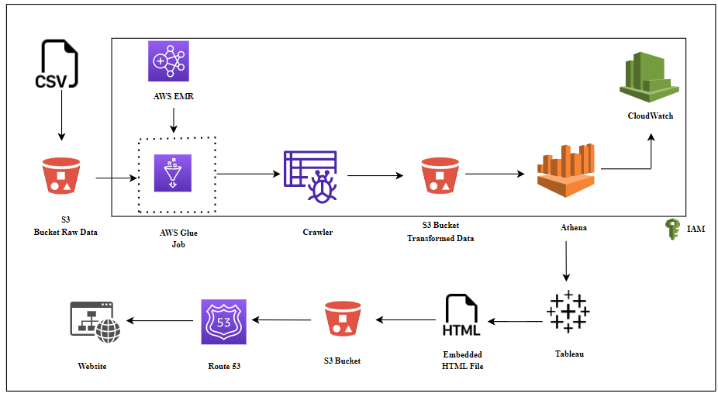
System Design & ETL Structure

Slide 8
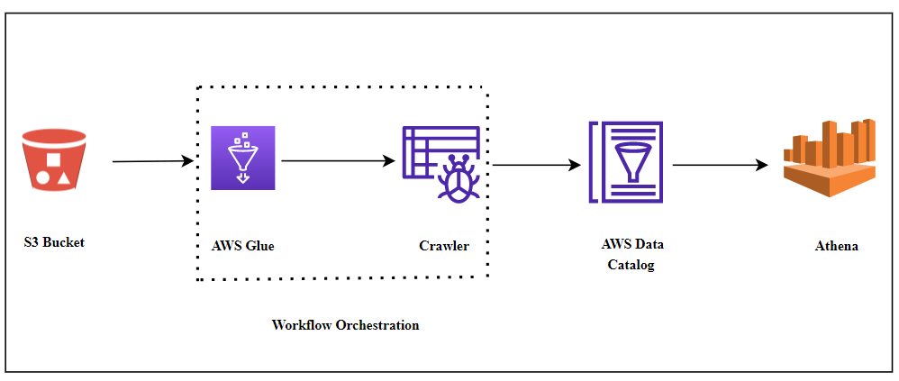
Data Transformation Process

Slide 9
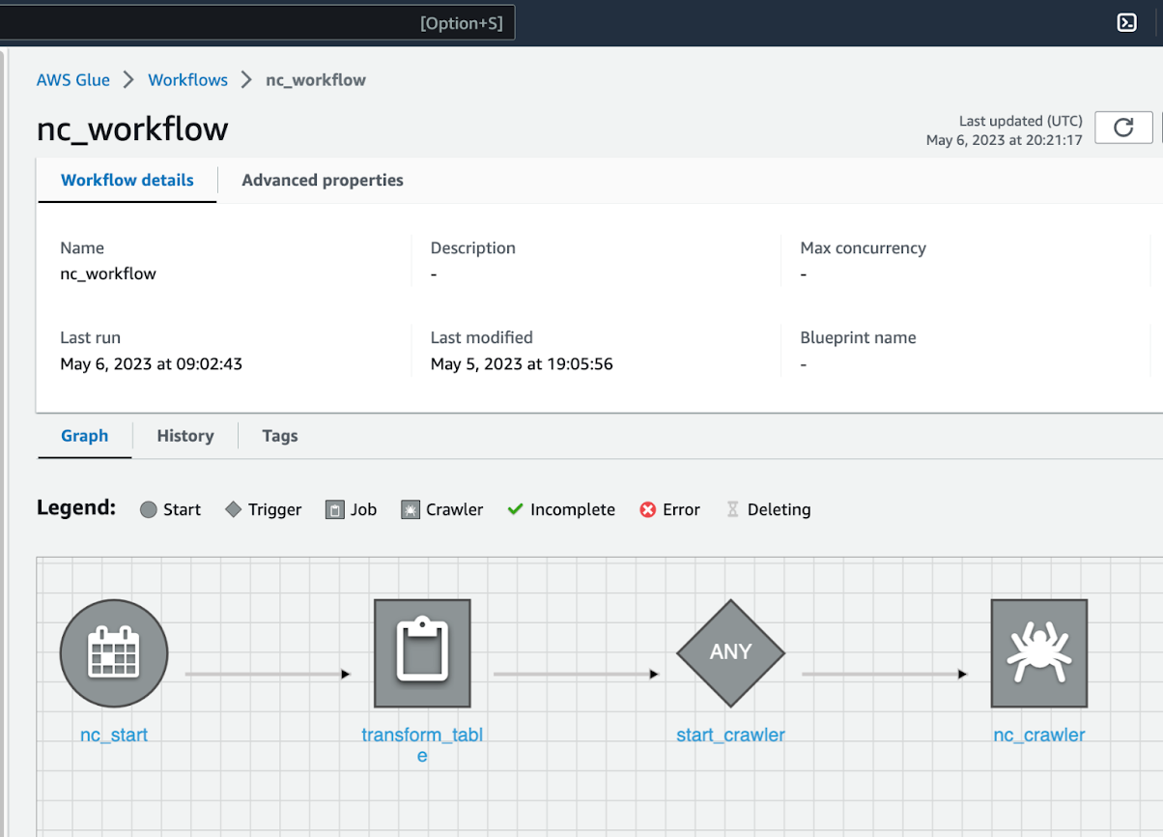
Workflow Execution & ETL Glue Job
A workflow named nc_workflow is executed to run a Glue job on raw data in an S3 bucket.
The Glue job performs ETL operations on the raw data, such as removing null values and spaces between column names, adjusting values in columns like city, original priority and fire prevention district.
After which, the crawler is run to create a schema in data catalog.
The transformed data is saved in a parquet format in an output folder in the same S3 bucket.

Slide 10
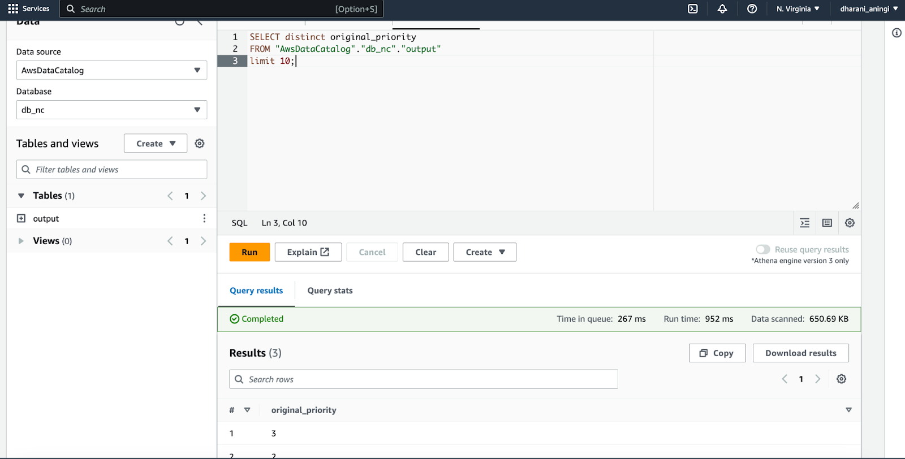
Data Analysis
We are using Amazon Athena as a data warehouse and queried the data to get insights using SQL.
As Athena is serverless, it can automatically scale up or down to accommodate the amount of data being queried.

Slide 11
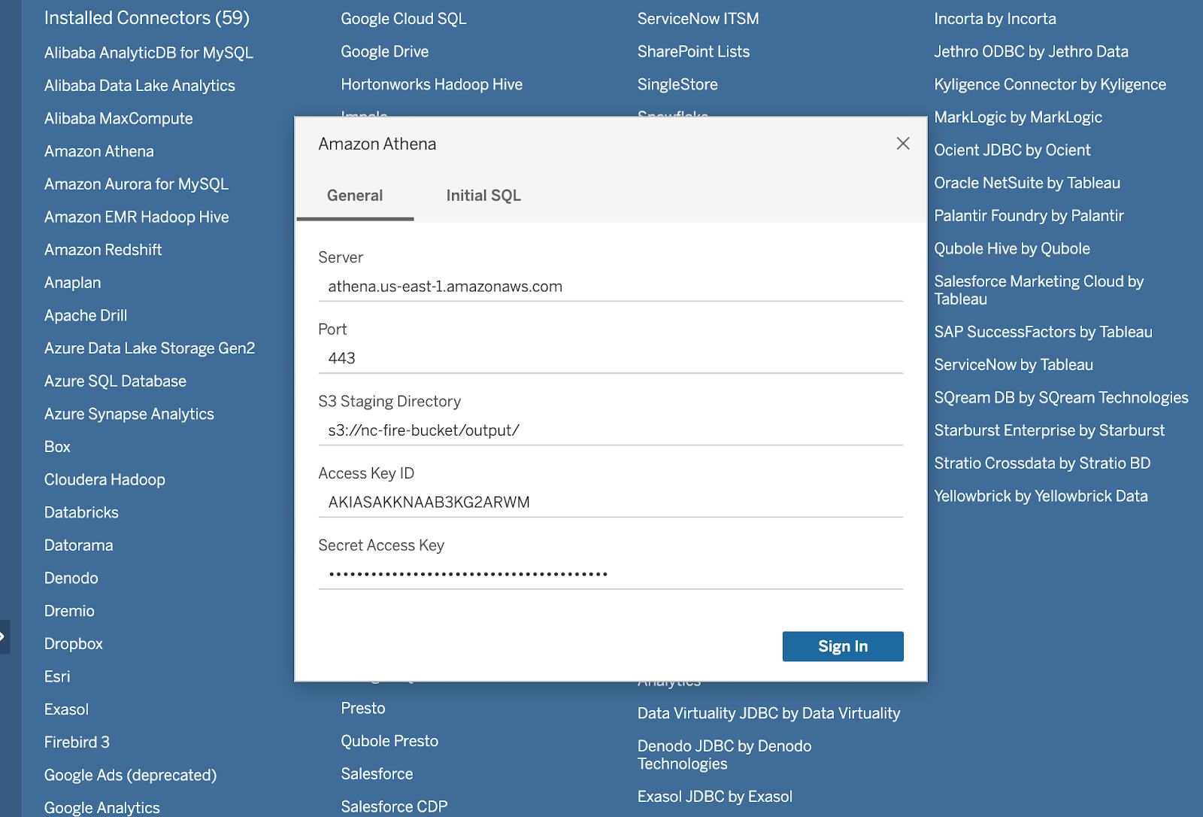
Tableau Connection
Tableau desktop is used to create connections with Athena for creating dashboards.
The server and port details along with S3 directory, Access Key ID and Secret Access Key from IAM user is used.

Slide 12
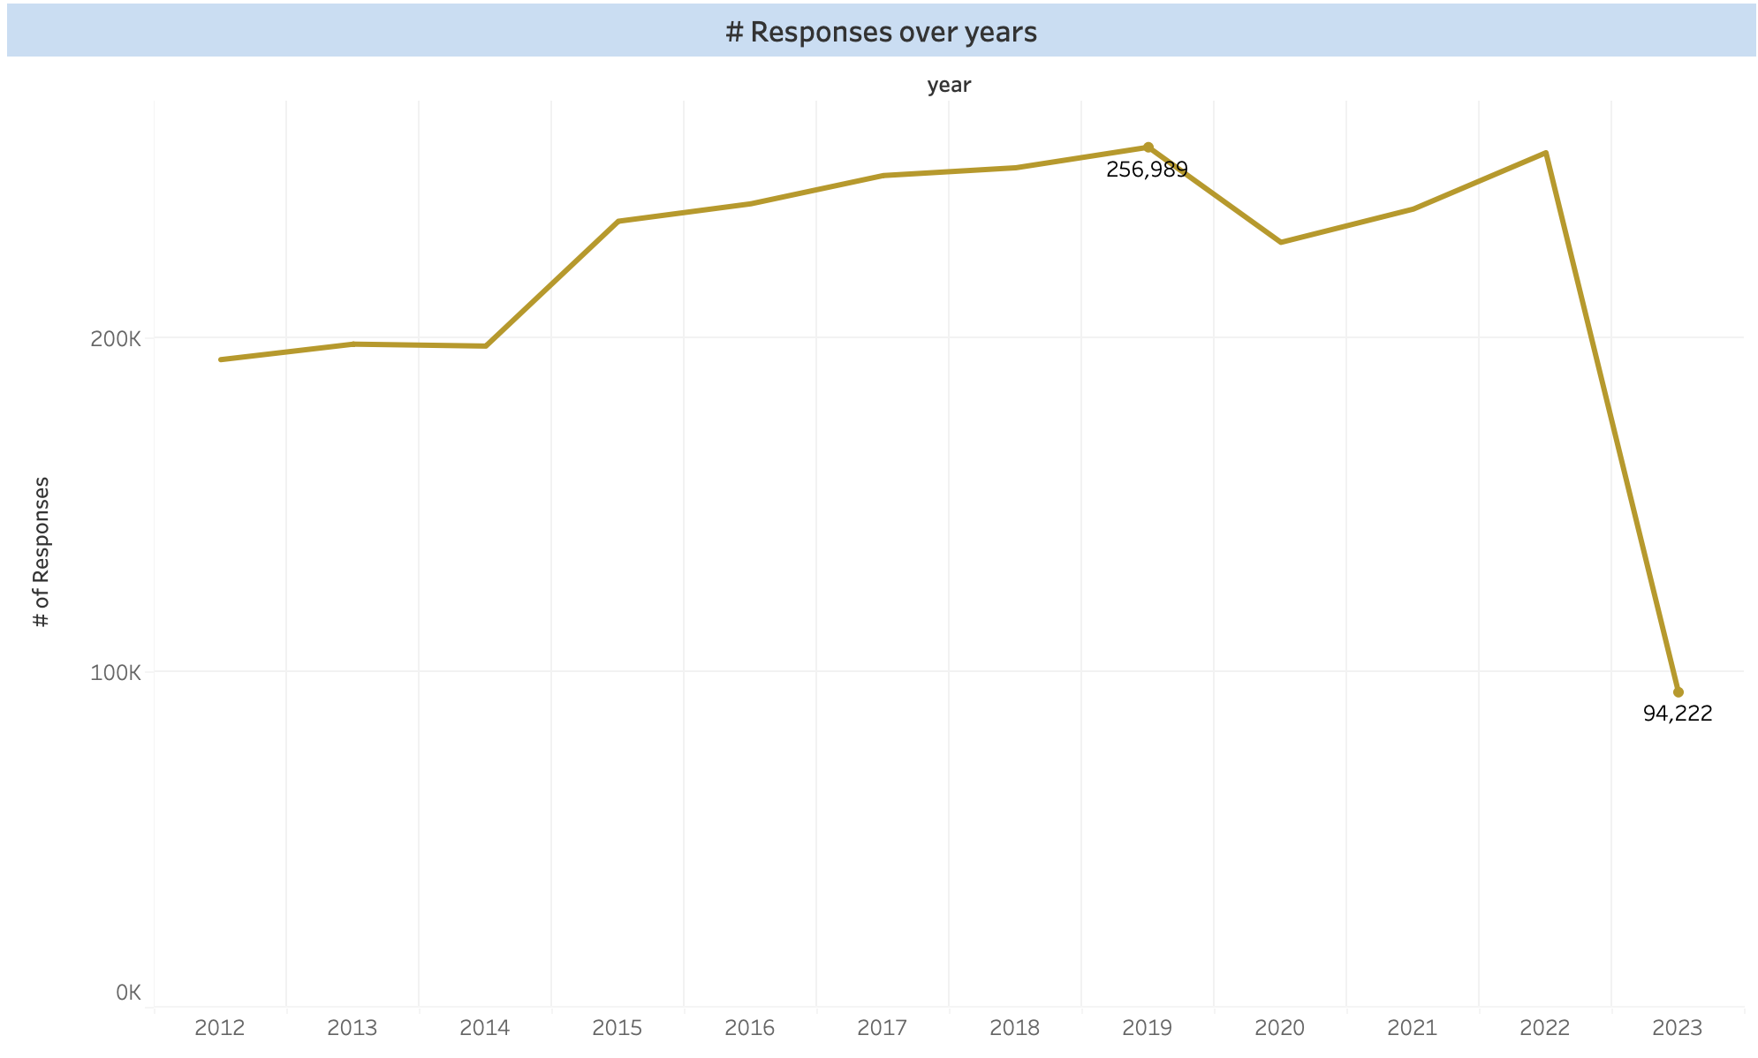
Data Visualizations
A line chart showing the number of responses given by the fire department over the years from the year 2012 till date.
Most number of Call Responses are seen in the year 2019 with 256,989 records. Followed by the year 2022 with 255,350 Responses.
Data from the year 2023 is yet to get updated for the call responses.

Slide 13
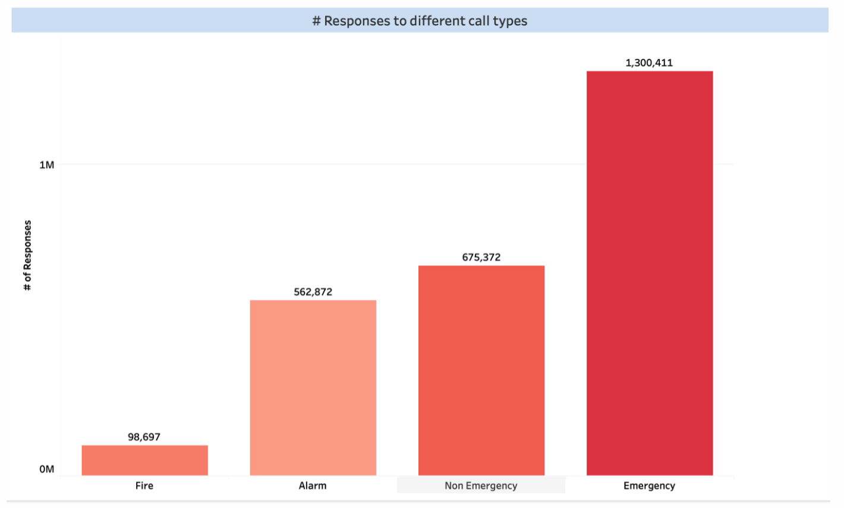
Data Visualizations
A bar graph which illustrates Responses to different call type groups.
The groups are categorized as Emergency, Non-Emergency, Alarm and Fire.
The most Responses received were for Emergency Call Type which is about 1,300,411. Non-Emergency comes in second with 675,372. Followed by the Alarm Call Type which are 562,872 and the least Responses are for Fire Call Types which are 98,697.

Slide 14
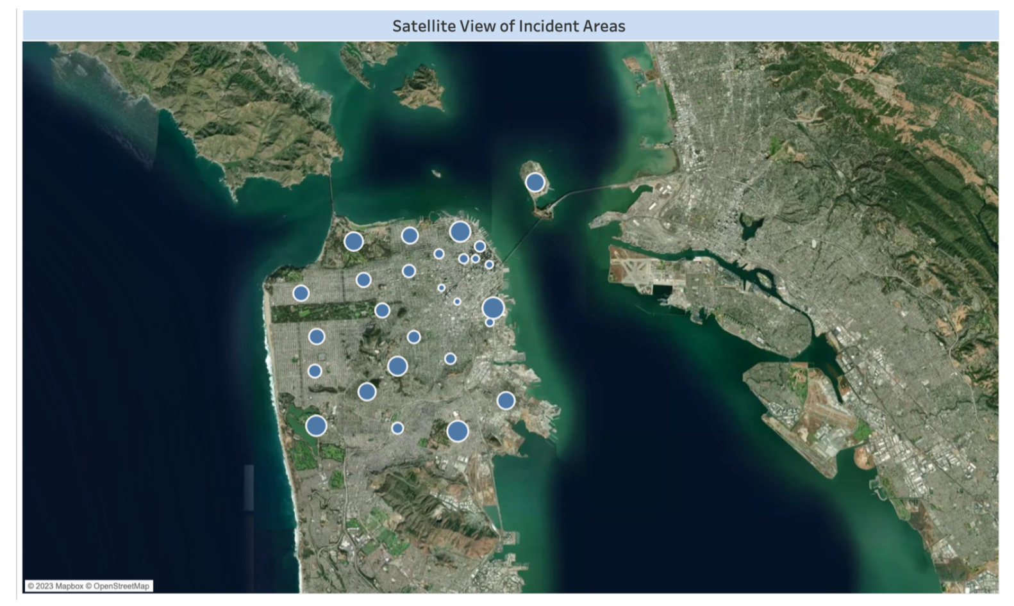
Data Visualizations
The map is a satellite view of the areas where the SF fire department has responded to service calls.
Some of the areas have bigger circles indicating areas having maximum number of responses from the department.

Slide 15
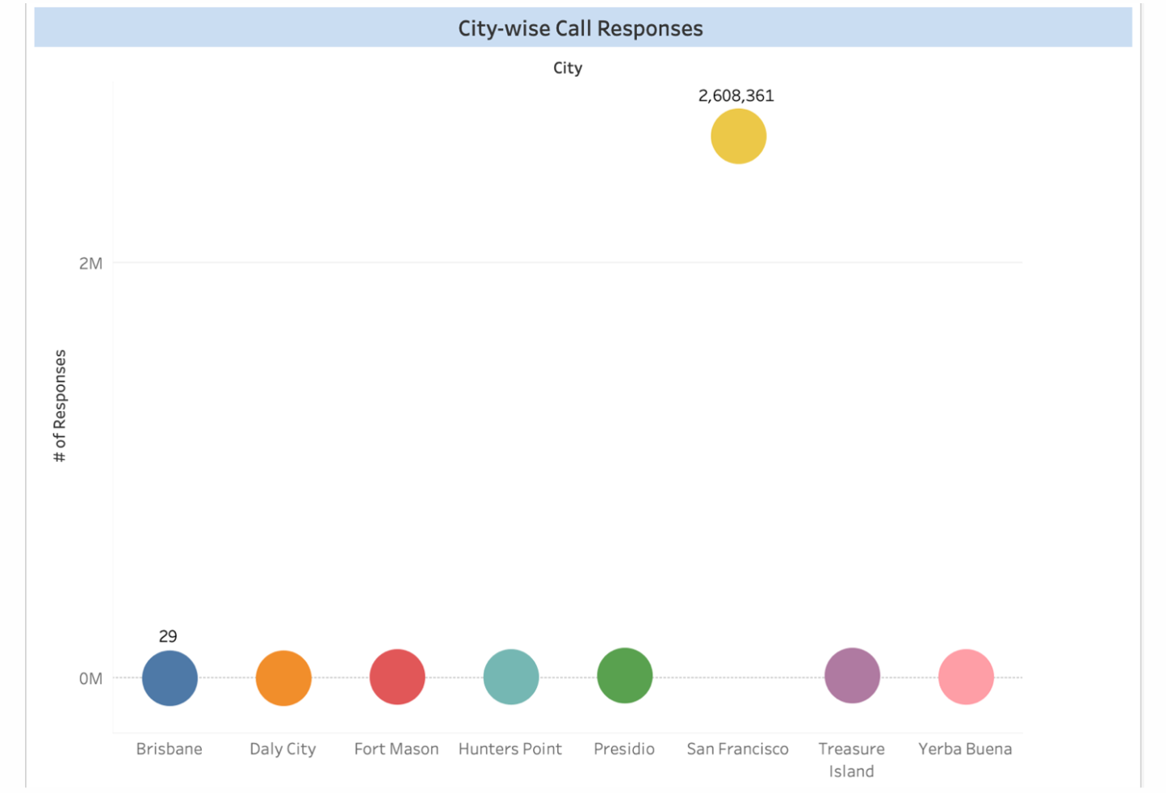
Data Visualizations
The chart depicts City-wise Call Response.
The city which had most Responses is San Francisco having almost 2,608,361 Responses. The next city having major Responses are Presidio with 12,295 Responses.
The city with least Responses is Brisbane with only 29 Responses.

Slide 16
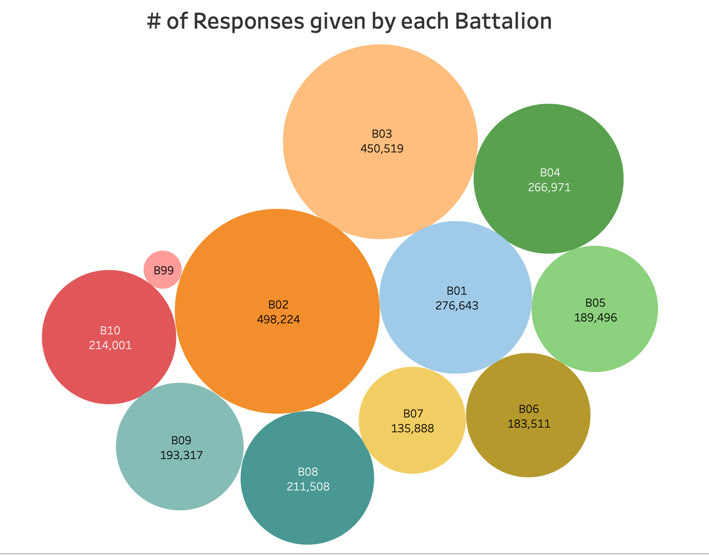
Data Visualizations
The above graph illustrates the Responses given by each Battalion.
The size of Bubbles indicates the number of Responses. The bigger the Bubble, the more number of responses it has been given.
According to the graph the most Responses were given by the B02 with 498,224. Followed by B03 with 450,519 Responses. The least number of Responses are given by B99 which are 17,272 Responses.

Slide 17
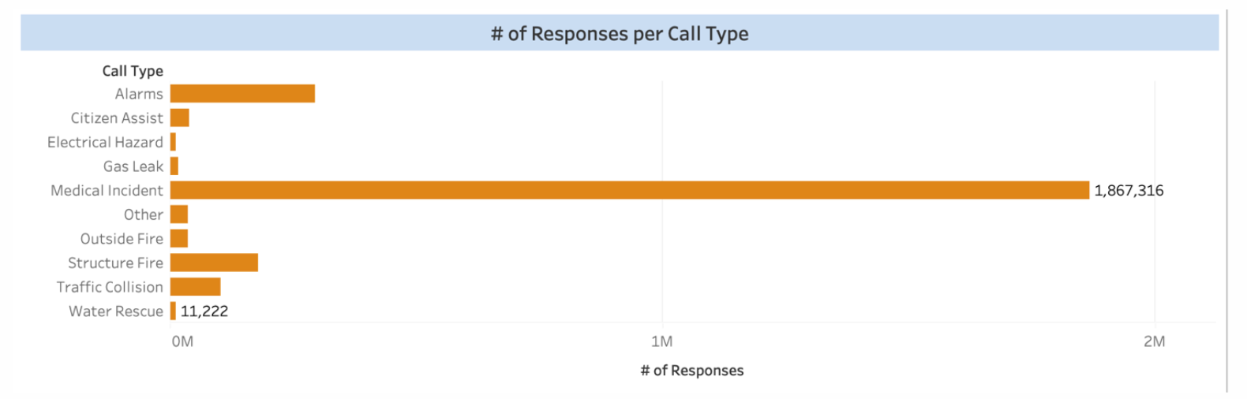
Data Visualizations
The graph depicts the number of responses for different call type.
We can see that 1,867,316 medical incidents accounted for the majority of responses. Water Rescue had the fewest responses, with only 11,222.
Alarms receive the second-highest number of responses, followed by structure fire and traffic collision. Compared to the prior Call Types, the Other Call Type did not receive as many responses.

Slide 18
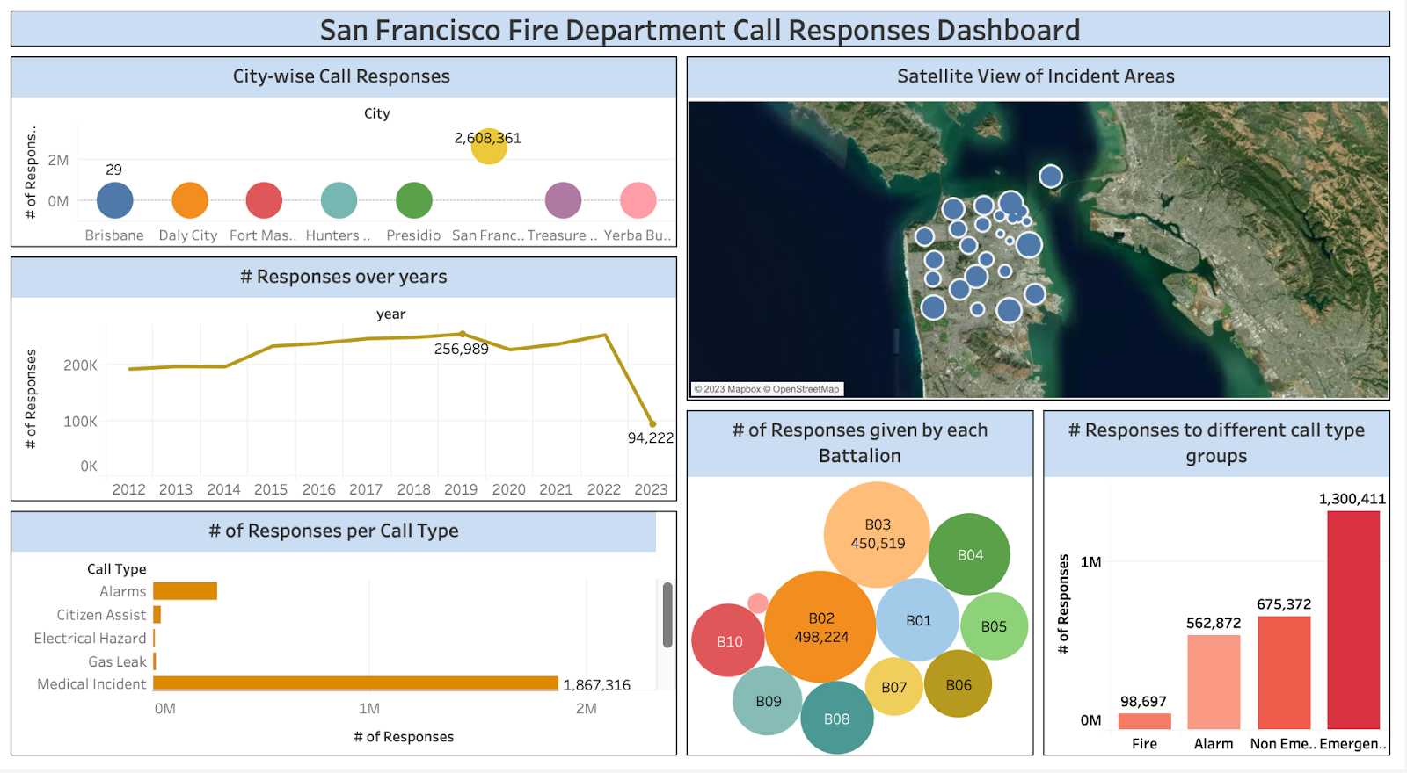
Tableau Dashboard

Slide 19
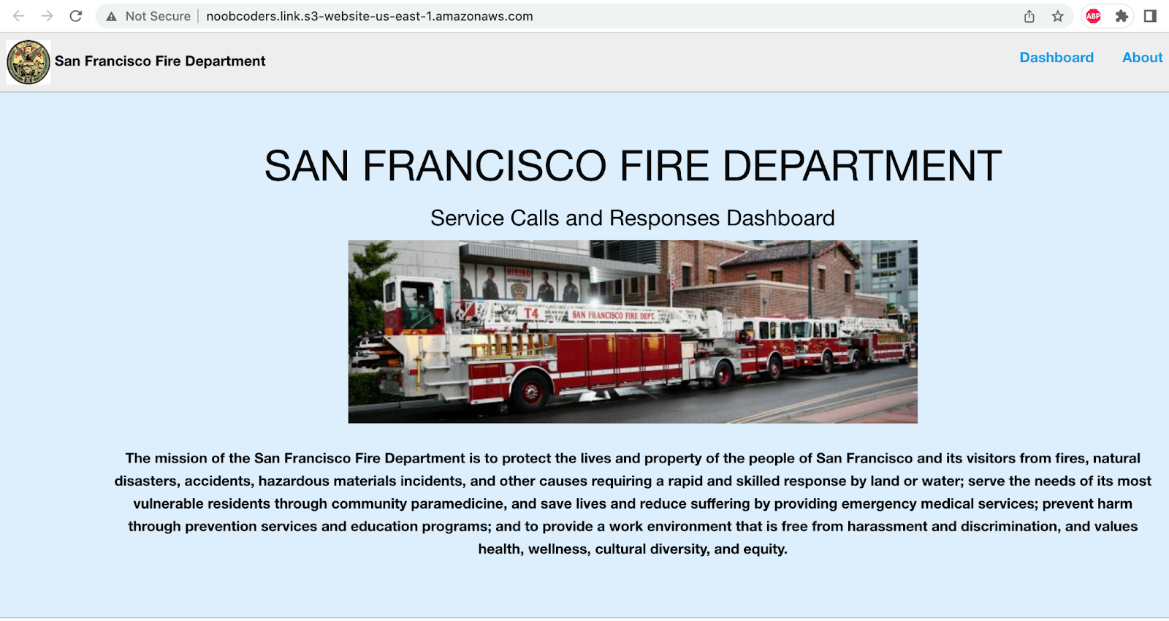
Web Integration
http://noobcoders.link.s3-website-us-east-1.amazonaws.com/

Slide 20
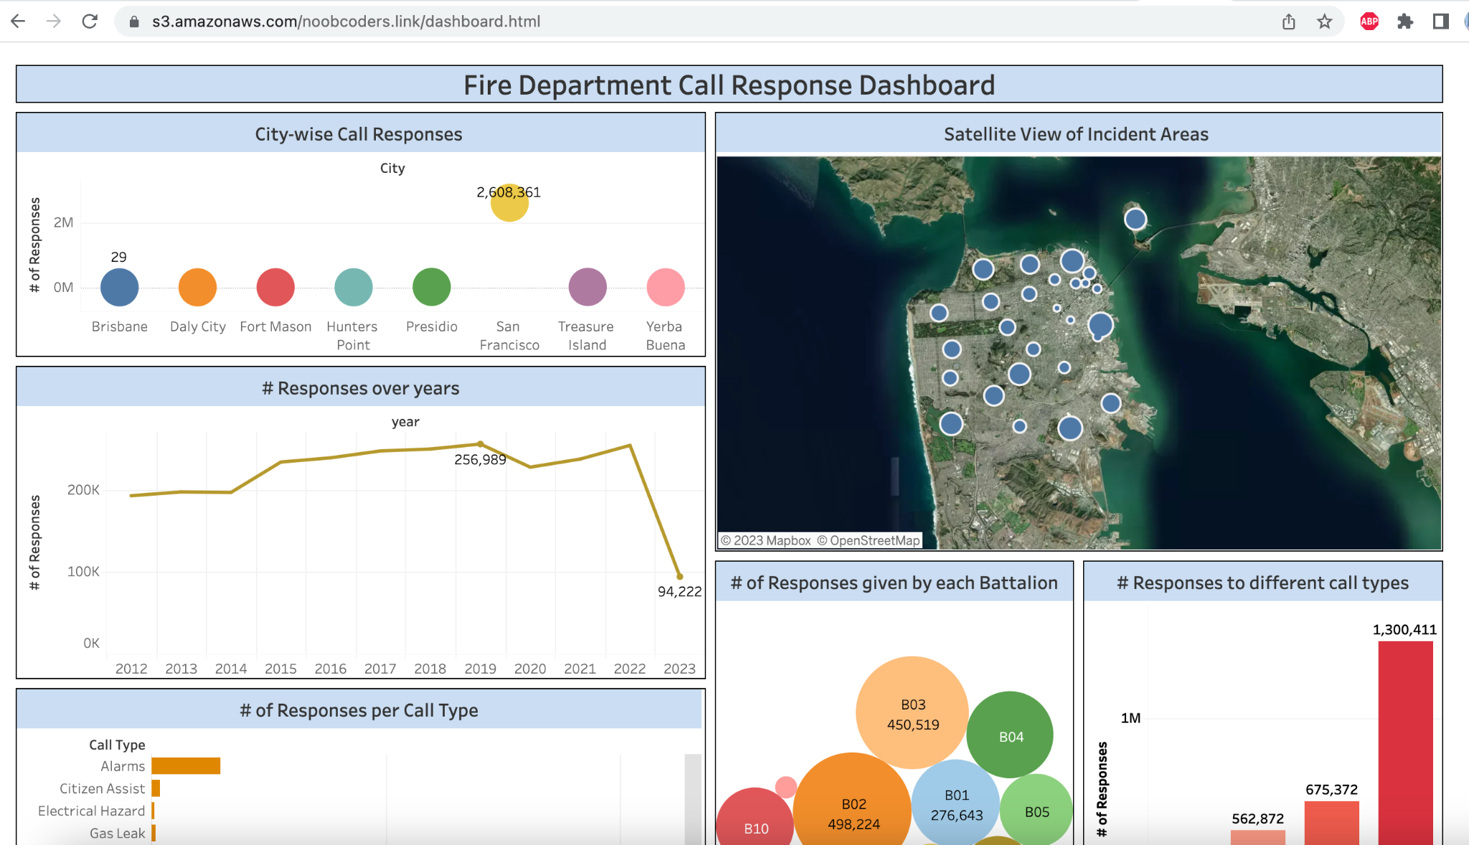
Web Integration
http://noobcoders.link.s3-website-us-east-1.amazonaws.com/

Slide 21

Conclusion
The project was implemented successfully utilizing various AWS services along with Tableau for gaining insights from data
A static website was hosted using Amazon S3 and Route 53, providing easy access to the dashboard visualizations and a detailed report on the project methodology, architecture, implementation, and results.
The team gained valuable experience in working with AWS tools and services, Pyspark and SQL for data processing and analysis, and Tableau for visualization.
The project provided a unique and challenging opportunity to apply skills and knowledge in a real-world setting, and it greatly enhanced the team's abilities as a data analyst.

Slide 22
Future Scope
Conducting a deeper analysis of the response times of SFFD to emergency calls is a potential area of exploration.
Exploring correlations between different variables in the SFFD dataset is another area for potential work.
Integrating external datasets with the SFFD data to provide more context and insights can be considered.
Creating predictive models that can forecast emergency incidents and their potential impact is also a potential area of exploration.
By continuing to analyze and optimize the data and exploring new approaches and techniques, emergency services can be further improved to enhance the safety and well-being of its citizens.

Slide 23

Thank You !

